Slide 1
FanFlyer:
Final Proposal Presentation
Steve Sorden, Travis Byakeddy, Corey Marcum, & Nathaniel Schaul

Slide 2
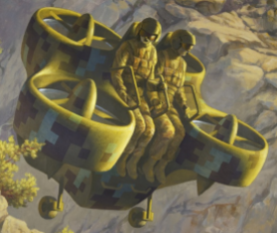
Project review
To provide a design for the internal aircraft frame that will be utilized by Novakinetics. The design is based on Finite Element Analysis modeling & simulations derived from forces the frame is expected to endure.

Slide 3
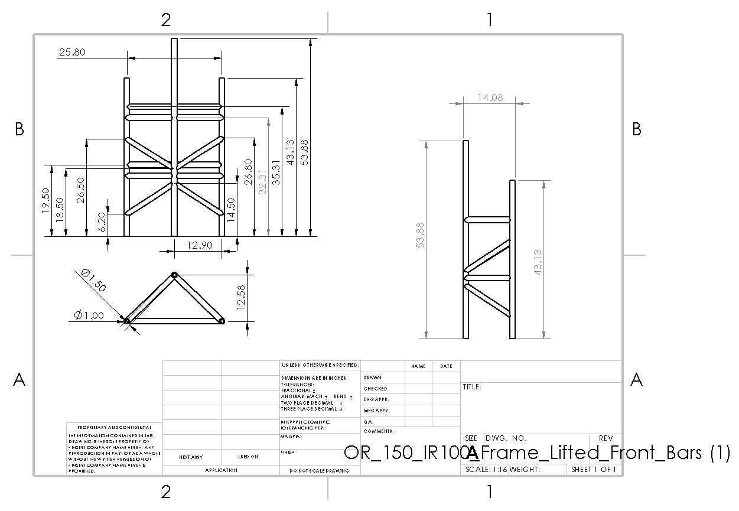
Original Novakinetics Frame Drawing

Slide 4
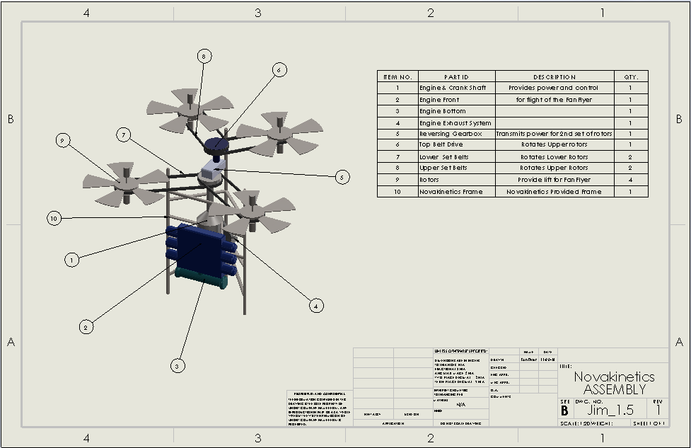
Novakinetics BOM w/Nova Frame

Slide 5
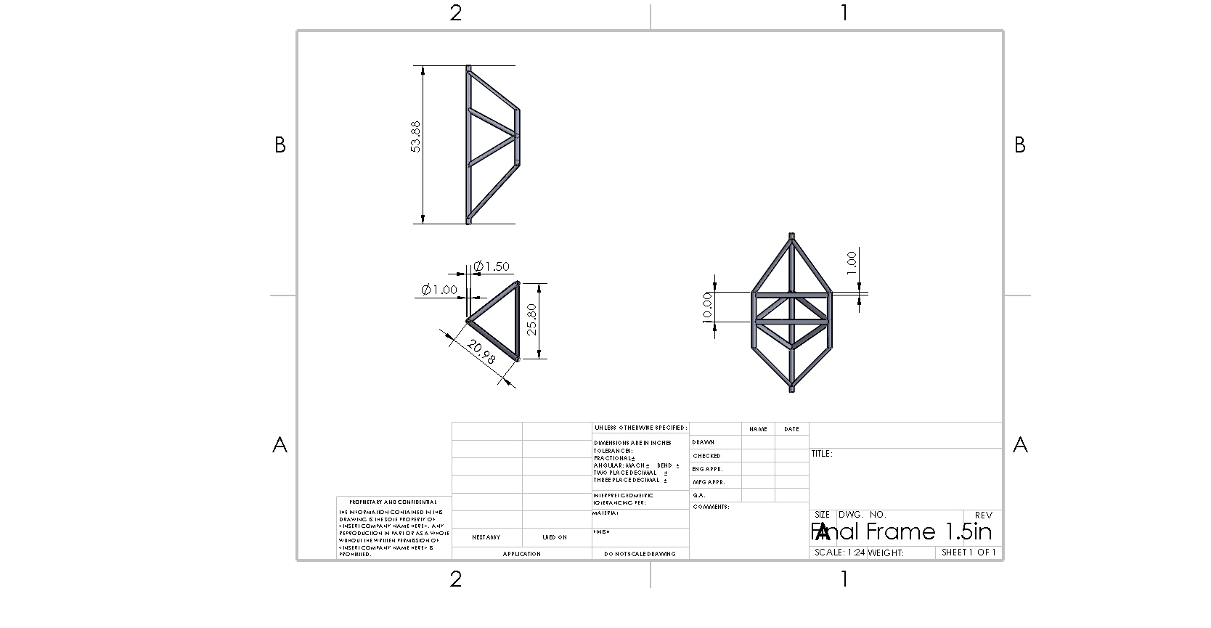
Final FanFlyer Frame Drawing

Slide 6
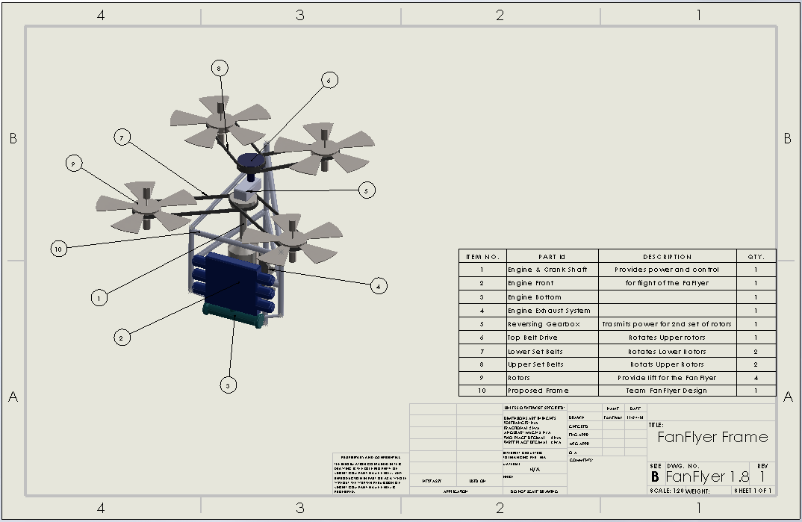
FanFlyer BOM w/ FanFlyer Frame

Slide 7
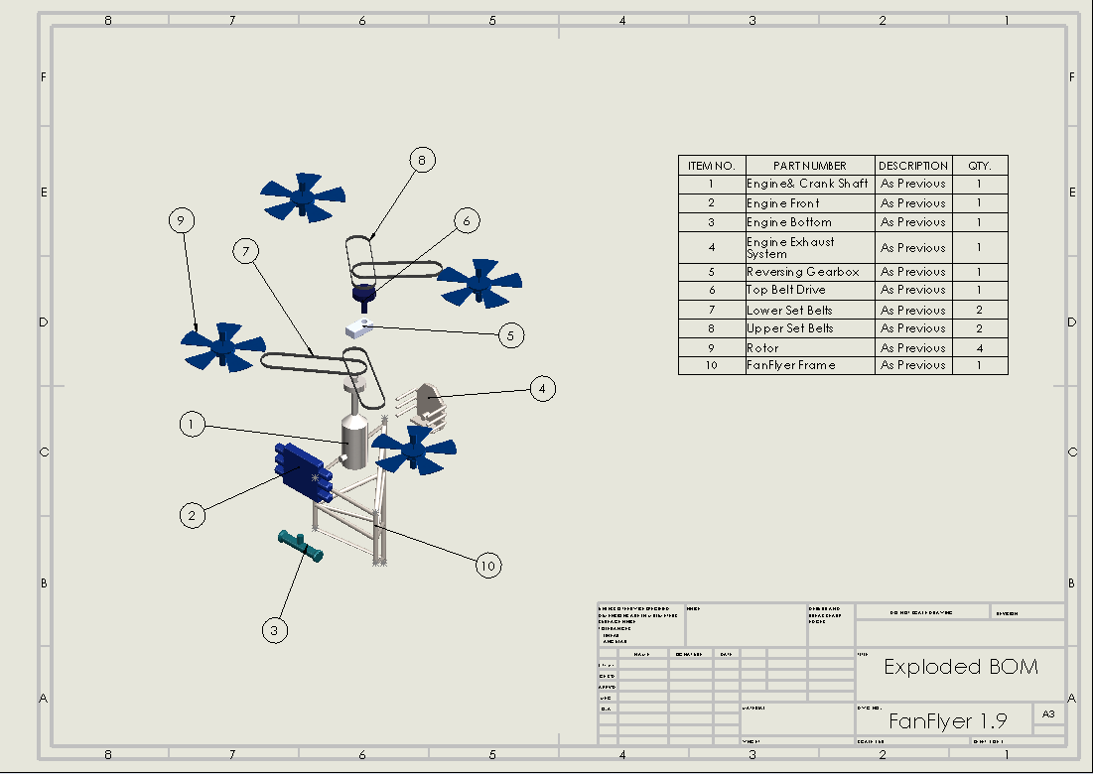
Exploded view of FanFlyer’s BOM

Slide 8
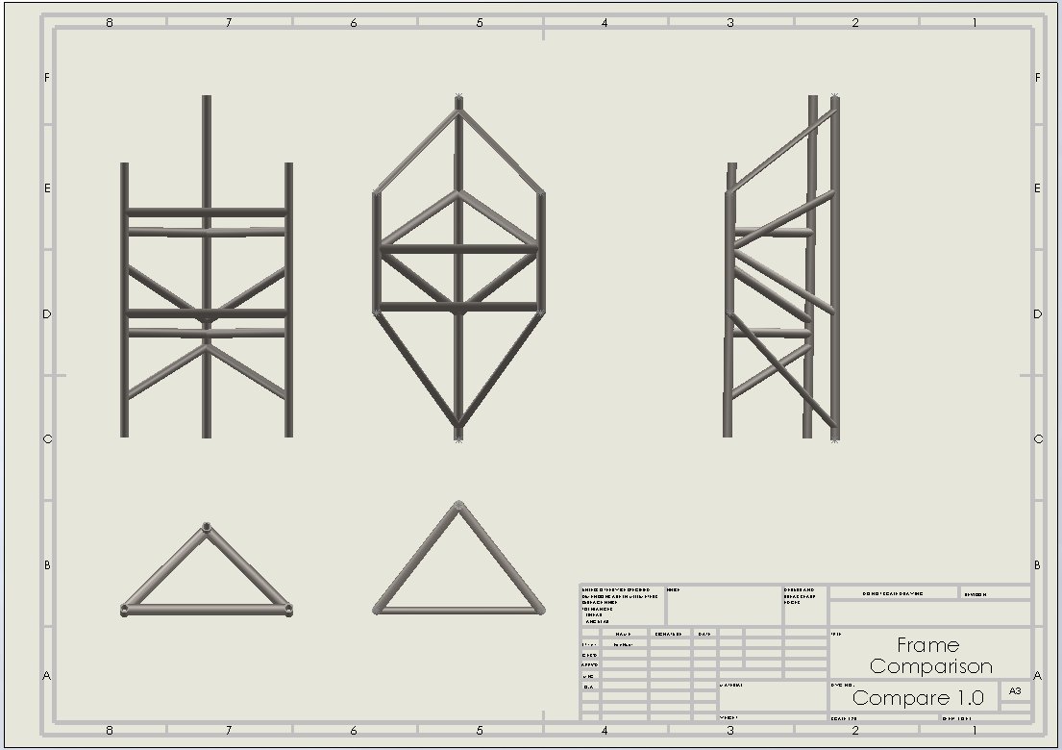
Novakinetics vs FanFlyer Frames

Slide 9
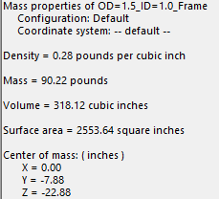
Design Requirements
Customer Requirements
Frames target weight: 50lb
Limited to 99lb
Structure must accommodate an 8ftx8ftx8ft volume
At or better design specifications
4130 Steel or better

Slide 10
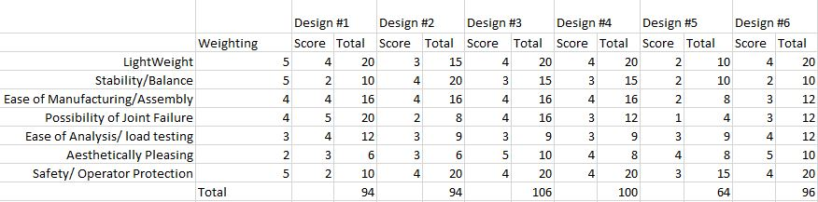
Design Description & Decision matrix
Similar size as original design
Low cost
Easy to assemble
Lightweight

Slide 11
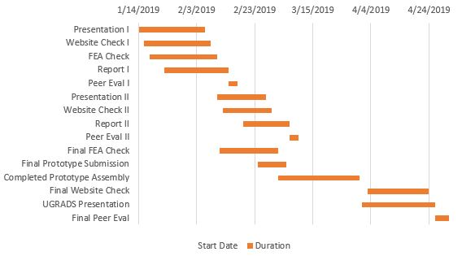
Schedule & Budget
Upcoming schedule for next term.

Slide 12
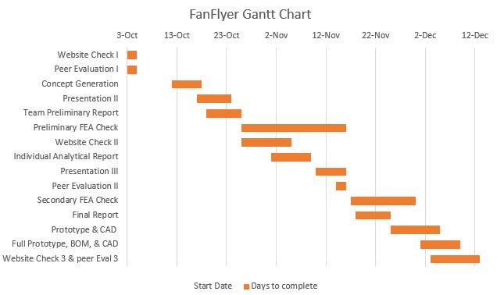
Schedule & Budget
Schedule for remainder of
Fall semester.

Slide 13
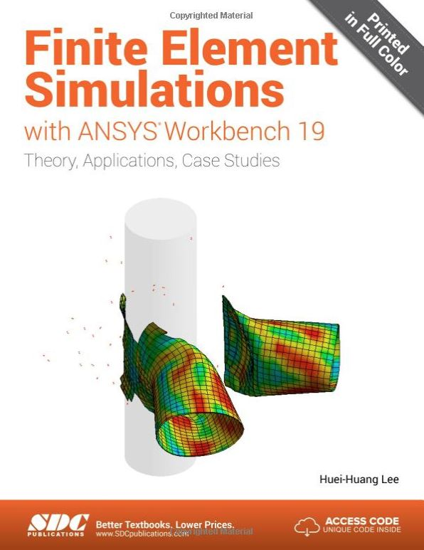
Schedule & Budget
Finite Element Simulations Textbook -$75
Future/Anticipated Resources -$150
Description of project budget.

Slide 14
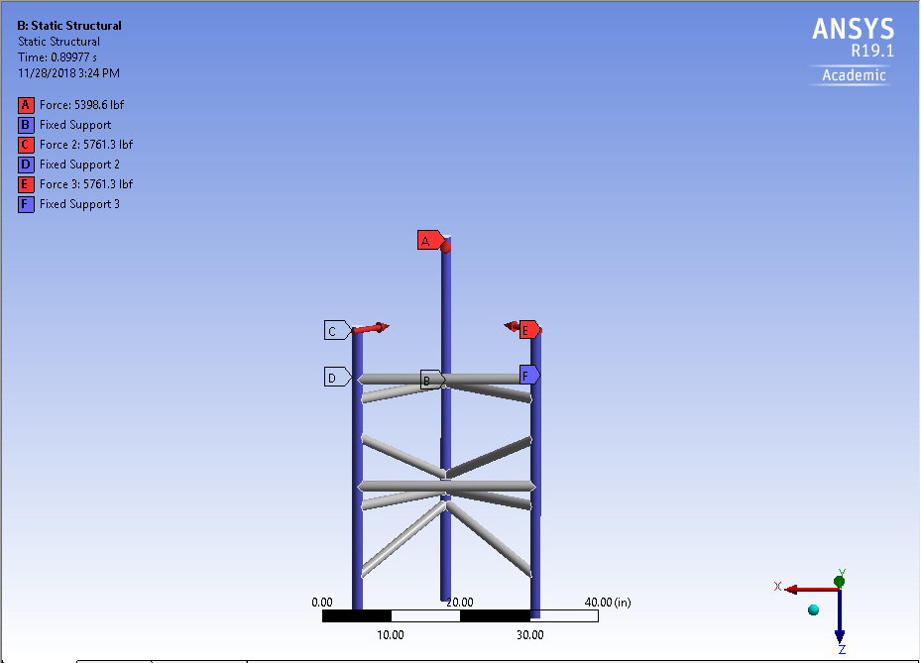
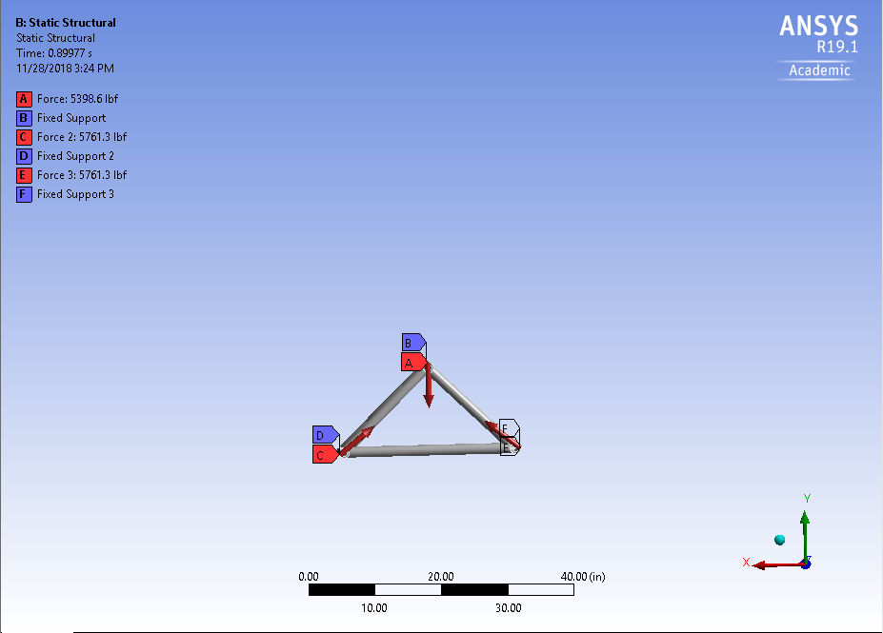
ANSYS update

Slide 15
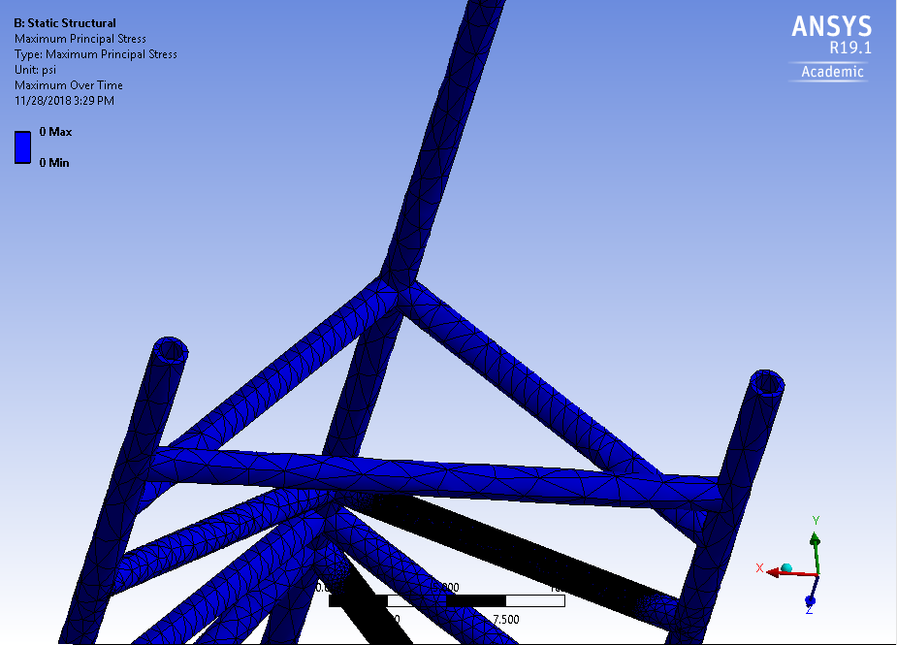
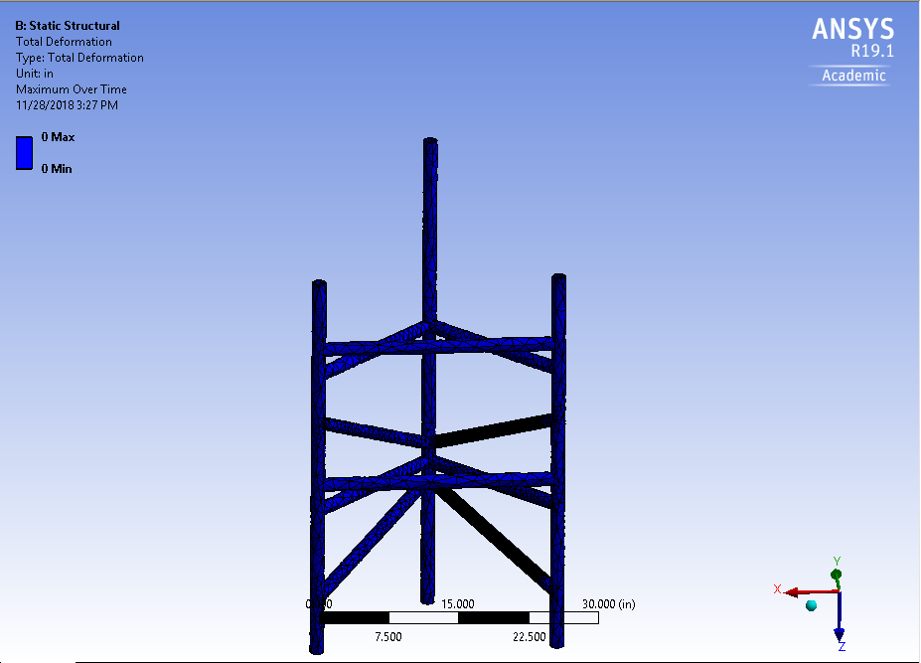
ANSYS Results

Slide 16
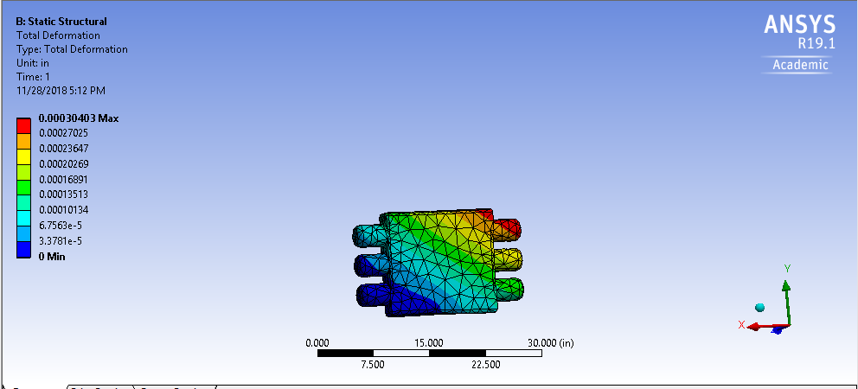
Simple Results

Slide 17
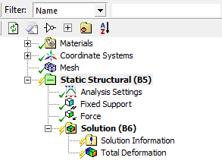
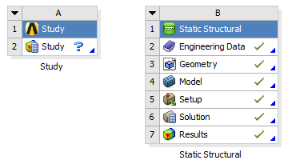
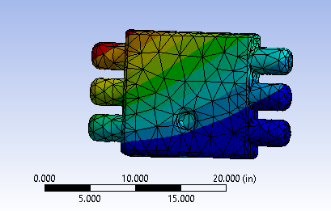
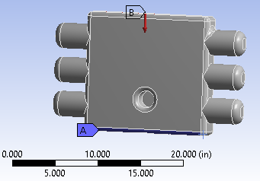
Simple Results

Slide 18
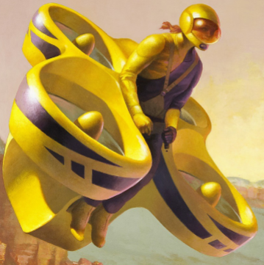
Thank You!
Questions?

